Slide 1

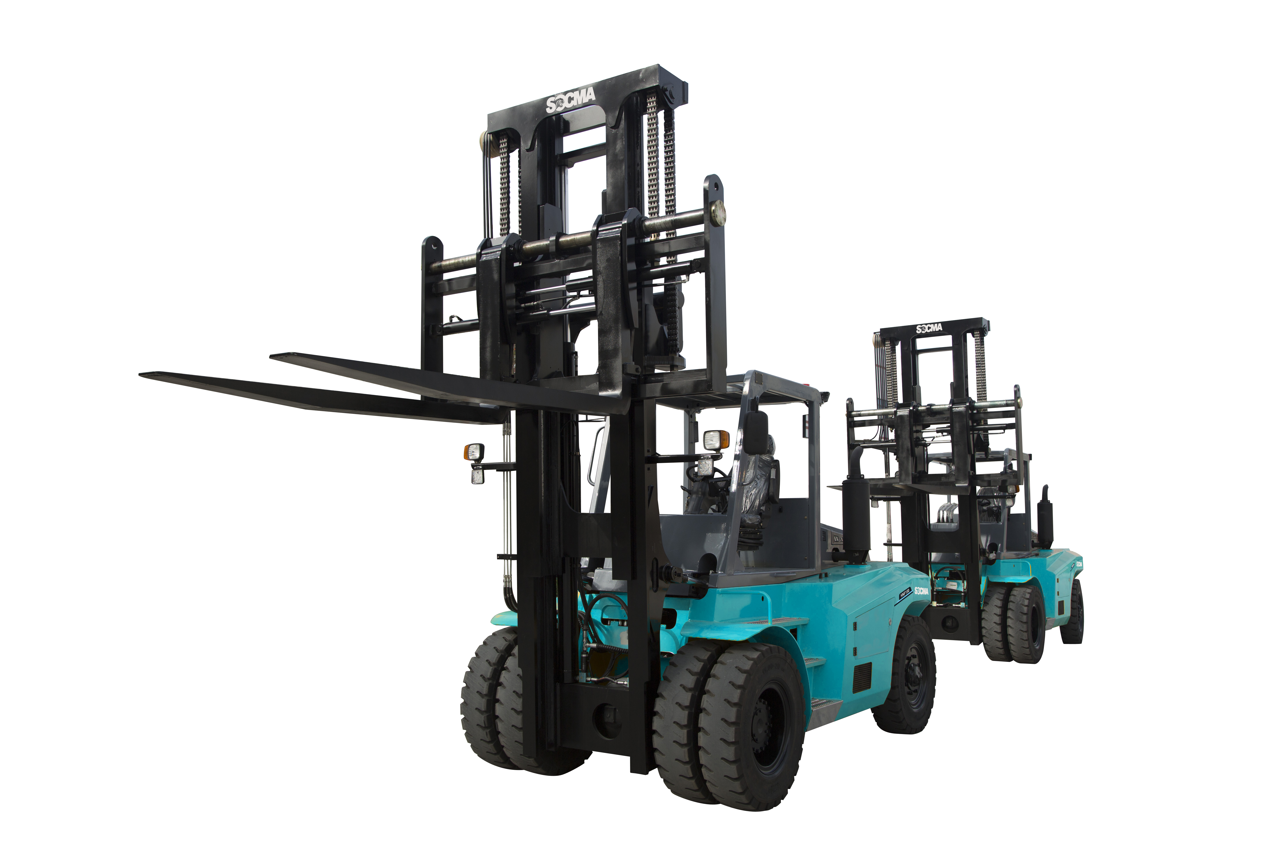
HNF 150S-160S Compact Efficiency @ Value
2022.10.19, Sunny Xu, SOCMA China

Slide 2
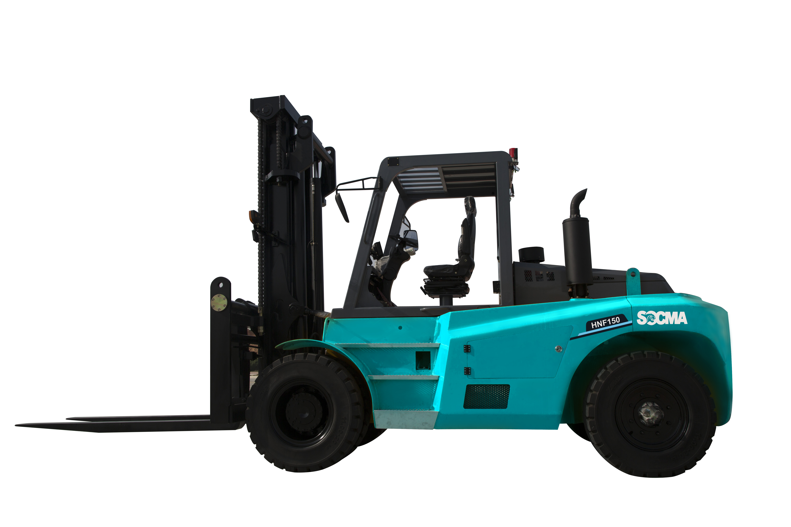

Slide 3
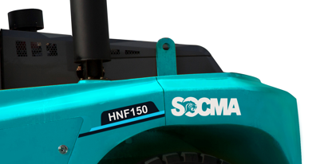
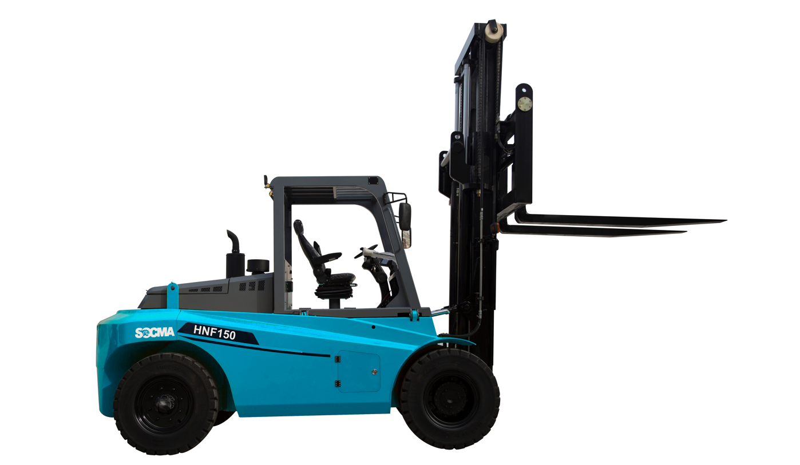
SOCMA compact 15-16ton forklift series
HNF 150S-160S Compact
Product range
Model description
H N F 150 - S
“Small” type-compact
HNF150S
Rated Capacity 15000kg@600mm
Rated Carrying Capacity 15ton
Diesel
HNF160S
Origin from SOCMA’s Chinese name”HUA NAN”
Rated Capacity 16000kg@600mm
Origin from SOCMA’s Chinese name”HUA NAN”
3
HNF150S-160S Standard | Sunny Xu | Q1 2022

Slide 4


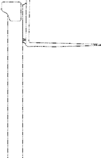


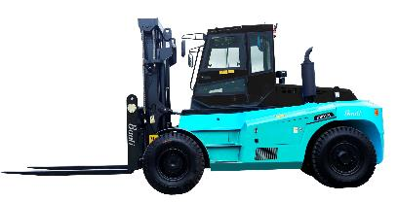



SOCMA compact 15-16ton forklift series
HNF 150S-160S Compact
Mast Lift Height 3000-5500mm
Load capacity 15-16T
[ varies depending on model and mast]
Travel speed 23.0~26.0km/h
[ varies depending on model and load]
Lowered Mast Height 3150-4400mm
Climbing ability with/without load 20/22%
Turning radius 4750mm
[ varies depending on model]
Lifting or Lowering speed with/without load lifting: 0.205-0.255m/s
lowering: 0.435-0.285m/s
4
HNF150S-160S Standard | Sunny Xu | Q1 2022

Slide 5
SOCMA compact 15-16ton forklift series
HNF 150S-160S Compact
For efficient and safe handling
ACTION POWERFUL
MOVING FAST
OPERATION SENSITIVE
USING DURABLE

Slide 6
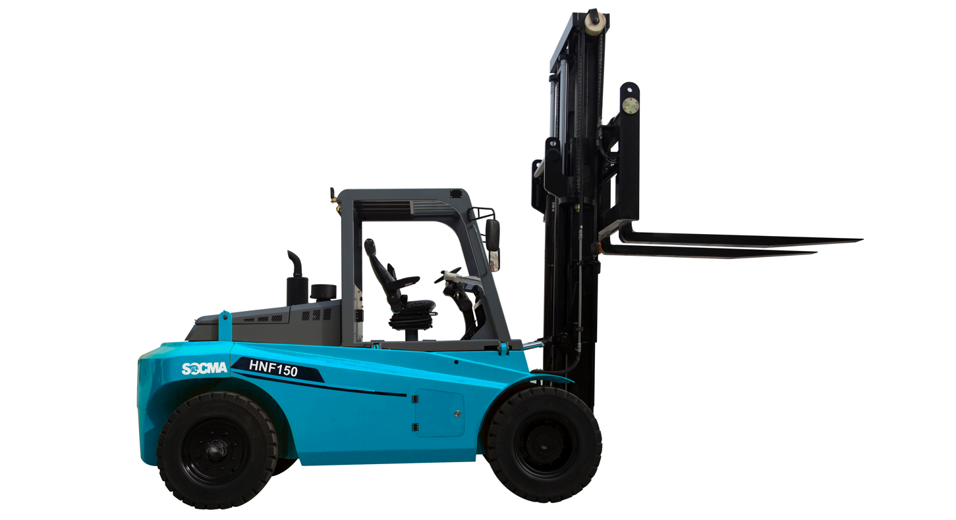
SOCMA compact 15-16ton forklift series
HNF 150-160 Compact
EFFORTLESS MAINTENANCE
with tilting cab
REMARKABLE VISIBILITY
with wide view cabin
OPERATED AT LOW COST
through low fuel consumption and predictable maintenance
OPERATES IN TIGHT SITUATIONS
the steering axle has small turning radius hanks to 3300 mm wheelbase

Slide 7
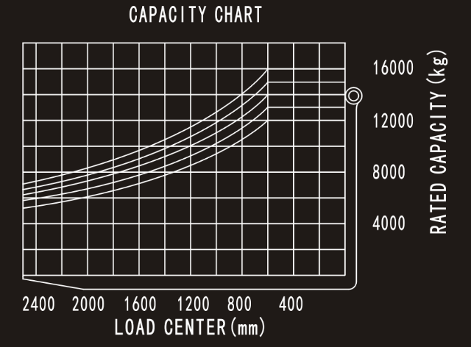
SOCMA compact 15-16ton forklift series
HNF 150S-160S Compact
Load capacity

Slide 8
SOCMA compact 15-16ton forklift series
HNF 150S-160S Compact
Data Sheet
SOCMA 16-тонный компактный дизельный вилочный погрузчик
Модель | - | HNF160S
Тип силовой установки | - | Дизель
Грузоподъемность | кг | 16000
Центр груза | мм | 600
Тип привода | - | 2WD
Размеры
Высота подъема | мм | 3000
Размеры вил (Д*Ш*В) | мм | 1200*180*90
Угол наклона мачты (вперед/назад) | Градусы | 6/12
Ширина каретки вил | мм | 2200
Общая длина (без вил) | мм | 5155
Общая ширина | мм | 2400
Высота мачты | мм | 3140
Высота козырька крыши | мм | 3040
Клиренс (рамы) | мм | 225
Минимальный радиус поворота | мм | 4750
Колесная база | мм | 3300
Колея передних колес | мм | 1740
Колея задних колес | мм | 2013
Собственный вес | мм | 19800

Slide 9
SOCMA compact 15-16ton forklift series
HNF 150S-160S Compact
Рабочие характеристики
Максимальная скорость (с грузом/без груза) | км/ч | 23/26
Скорость подъема вил (с грузом/без груза) | мм/с | 205/255
Скорость опускания вил (с грузом/без груза) | мм/с | 435/285
Способность преодолевать подъем (с грузом/без груза) | Градусы | 20/22
Шины
Передние шины | - | 12.00-20-18PR
Задние шины | - | 11.00-20-18PR
Тип шин | - | Пневматические шины
Количество шин (перед/зад) | шт. | 4/2
Двигатель и трансмиссия
АКБ | В/А/ч | 2х12/90
Производитель двигателя |  | Dongfeng Cummins
Модель двигателя |  | National III QSB4.5-C130
Номинальная мощность двигателя | кВт/об.мин. | 97/2200

Slide 10
SOCMA compact 15-16ton forklift series
HNF 150S-160S Compact
5.5 | Номинальный крутящий момент | Н*м/об.мин. | 418/1500
5.6 | Количество цилиндров | шт. | 4
5.7 | Рабочий объем двигателя | л | 4,5
5.8 | Рабочее давление навесного оборудования | МПа | 16
5.9 | Рабочий поток масла при использовании навесного оборудования | л/мин. | 40
5.10 | Трансмиссия |  | 2/2 Power Shift
5.11 | Тип трансмиссии |  | Трансмиссия с гидравлической муфтой

Slide 11
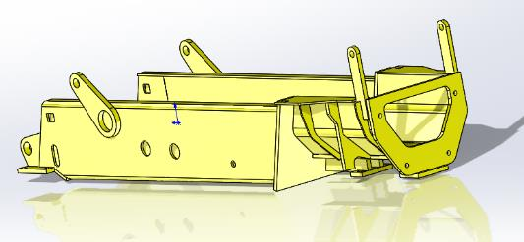
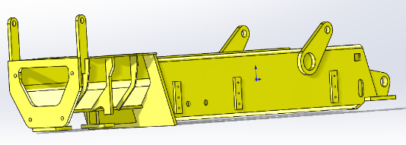
SOCMA compact 15-16ton forklift series
HNF 150S-160S Compact
Chassis
This is subjected to Finite Element Analysis(FEA) to ensure that there is always enough safety margin under severe working conditions; the workmanship is exquisite and firm. Effectively alignment with axles and transmission to ensure the lateral and longitudinal stability and energy saving of the entire vehicle operation process
Box type chassis
Strong welded structure
Anti-slip steps
Good rigidity and strength

Slide 12
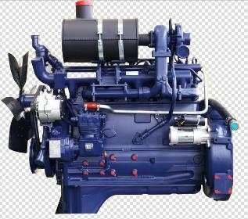
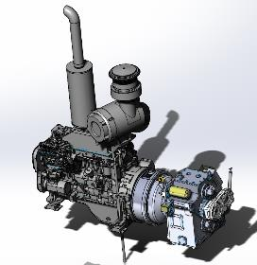
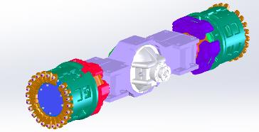
SOCMA compact 15-16ton forklift series
HNF 150S-160S Compact
Drivetrain
Engine-well-known turbocharged engine: strong horsepower, large torque reserve, low fuel consumption, high reliability; easy access to accessories
Yuchai YC6J150-T301
Dongfeng Cummins 6BT5.9-C130 CN2
Dongfeng Cummins QSB4.5-C130 Euro III
Transmission-automatic shift transmission can change gears very smoothly, reliable, safe, and easy to maintain.
2 FW/2RW
Drive axle-adopts a heavy-duty forklift drive axle
Large load capacity
Long service life
Heavy duty Air filter

Slide 13
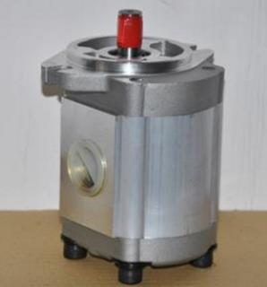
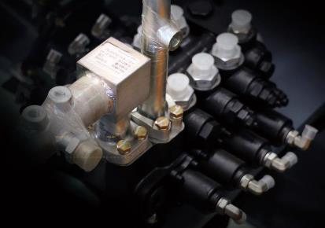
SOCMA compact 15-16ton forklift series
HNF 150S-160S Compact
Hydraulic System
Double pumps merge, steering priority hydraulic system
Equipped with oil return radiator and back pressure protection device to ensure the heat balance of the whole machine.
Single-handle joystick control valve and electronically controlled variable speed control valve, make operation of the whole machine lighter and more flexible
Full hydraulic steering priority system, with effortless action and control

Slide 14
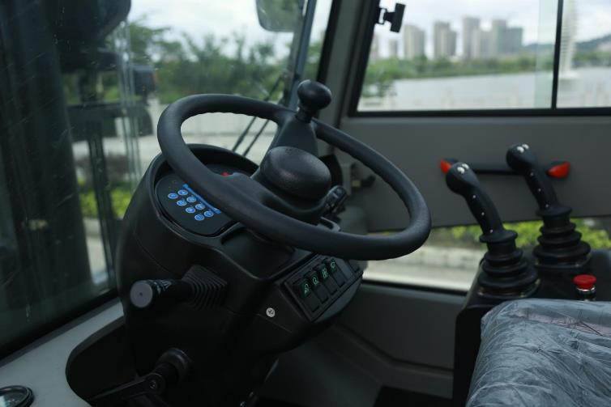
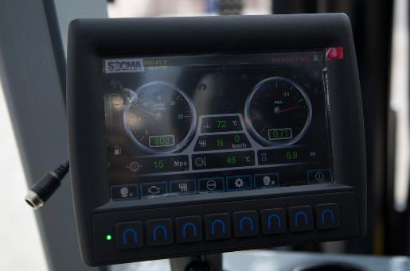
SOCMA compact 15-16ton forklift series
HNF 150-160 Compact
Controls
Pilot valve control device to make the work efficient and reduce drivers’ labor intensity.
Joystick controlled mast and carriage operation.
Drive direction controlled lever on steering column
Operator’s color display indicator 6”
Engine RPM, Temperature, Fuel level, Working hours
Drive direction FNR
Brake system air pressure & hydraulic oil pressure
Optional load indicator & printer

Slide 15
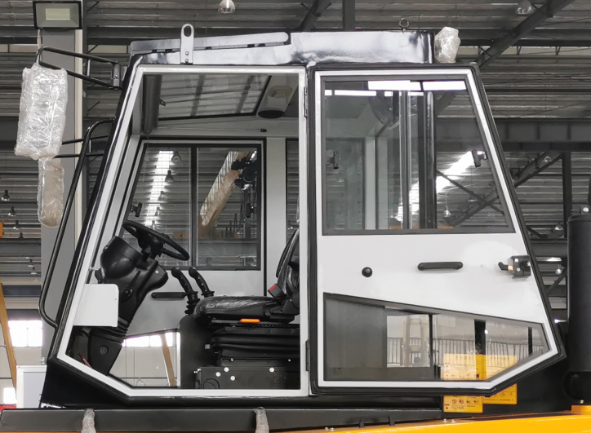
SOCMA compact 15-16ton forklift series
HNF 150S-160S Compact
Cabin
Sliding windows L / R
Doors both sides
Wipers
Front, rear
Heating system
Air conditioning system
Suspended frame, comfortable and spacious.
Seat front /rear and height adjustable
Wheel column angle is adjustable
At glance controls and display
Operator’s presence system optional

Slide 16
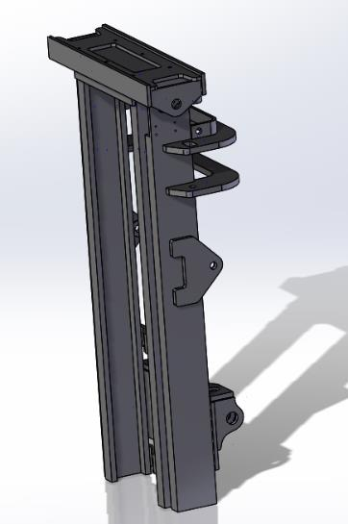
SOCMA compact 15-16ton forklift series
HNF 150S-160S Compact
Mast
Box-type internal-external mast, special all-round roller bearings, increase lifting performance
Lifting height
3m duplex as standard
3-5.5m as option
Lifting speed
0.205m/s- 0.255m/s with full load/without load
Lowering speed
0.435m/s-0.285m/s without load/with full load

Slide 17
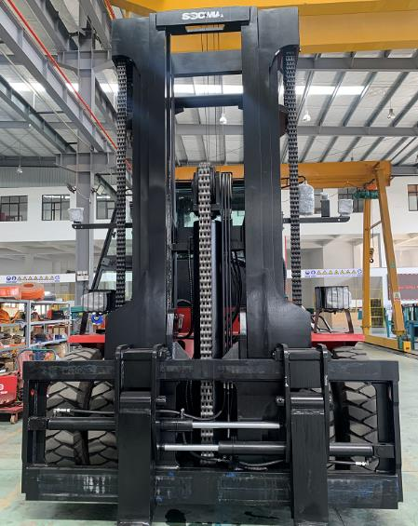
SOCMA compact 15-16ton forklift series
HNF 150S-160S Compact
Free Mast
Lifting height
3m duplex wide view type as standard
3-5.5m duplex/triplex free mast as option
Freelift 998-1833mm as option
Lifting speed
0.205m/s- 0.255m/s with full load/without load
Lowering speed
0.435m/s-0.285m/s without load/with full load

Slide 18
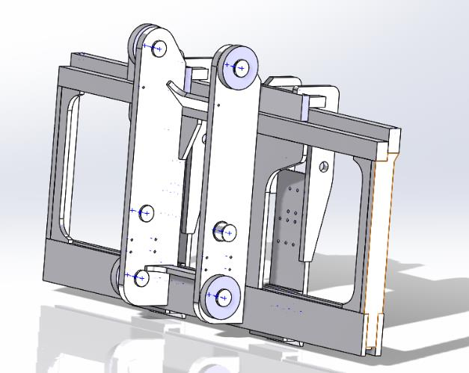
SOCMA compact 15-16ton forklift series
HNF 150S-160S Compact
Carriage
Strong and durable construction, tested through Finite Element Analysis(FEA), it can resist high intensity operations.
Durable & robust design
Full stroke
Standard with fork positioner and side shifter
Optional design for stone and mining application

Slide 19
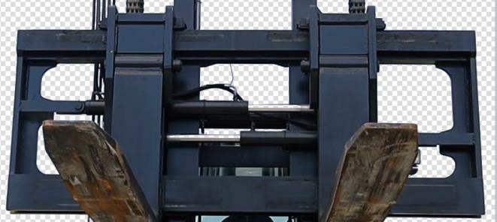
SOCMA compact 15-16ton forklift series
HNF 150S-160S Compact
Forks
Standard dotation
1200x180X90
CASCADE brand, stronger, more wear-resistant,
Optional with alternative customized lengths
Quick interchangeable and replaceable

Slide 20
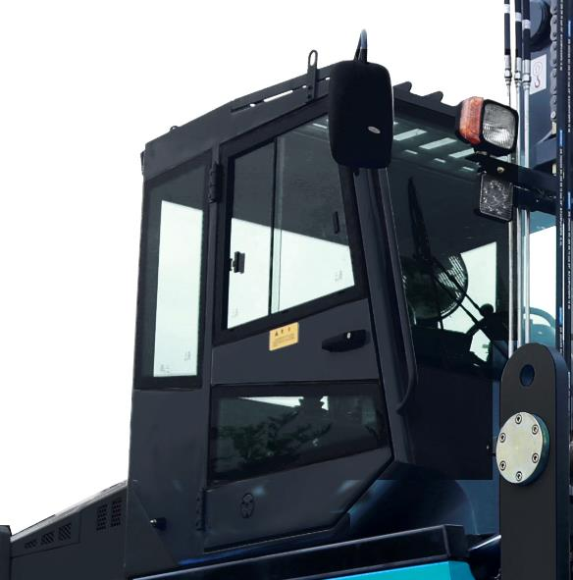
SOCMA compact 15-16ton forklift series
HNF 150S-160S Compact
Maintenence
Easy access to preventive maintenance components
Engine hood with assisting pneumatic spring
Cabin can be tilted to the right for maintenance access

Slide 21
THANK YOU!
Notes:
Chart layout »Chapter chart«

